Slide 1
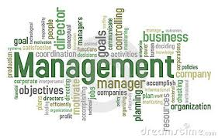
Management Introduction

Slide 2
What is Management ???
Management By Koontz : The process of designing and maintaining an environment in which individuals, working together in groups, efficiently to accomplish the organizational objectives
Management By Henri Fayol : Management is conduct of affairs of business, moving towards its objectives through a continuous process of improvement and optimization of resources.
Management By Mary Parker Follete : Management is the art of getting things done through people.

Slide 3
What is Management
Management by George R Terry : Management is a process consisting of planning, organizing, directing, and controlling, performed to determine and accomplish the objectives by use of people and resources.
Management by ILO : Management is the complex of continuously coordinated activity by means of which any undertaking administration/public or private service conducts its business .
Management by Lawrence A. Apple : Management is guiding human and physical resources into a dynamic, hard hitting organization until that attains its objectives to the satisfaction of those served and with a high degree of morale and sense of attainment on the part of those rendering the service .

Slide 4
Nature & Characteristics of Management
Nature
Multi Disciplinary
Universal application
Dynamic nature of Principles
Decision Making
Management Principles are relative and not absolute
It is a Discipline/Career/Profession
Management is a Science and an Art as well

Slide 5
Characteristics
is a critical element in Economical Growth of a country
Management is the dynamic and life giving element in any organization
Management aims at achieving Predetermined Objectives
Management is a continuous Process
Management aims at the coordination of Resources and manpower towards the output

Slide 6
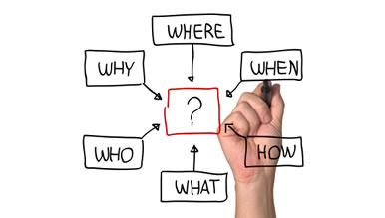
Functions of Management
1.Planning

Slide 7
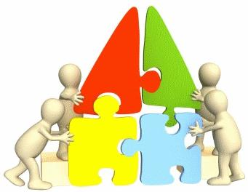
Functions of Management
2.Organizing

Slide 8

Functions of Management
3.Staffing

Slide 9

Functions of Management
4.Directing

Slide 10

Functions of Management
5.Controlling

Slide 11
Functional areas of Management
Production: Purchasing, Materials Management, R&D
Marketing: Market Research and advertising, Sales Management
Finance and Accounting: Costing, Investment Management, Taxation
Personnel: Recruitment, Selection, Training & Development, Wage & Salary Administration, Performance Appraisal

Slide 12
Roles of Management
Interpersonal roles
The figurehead role (performing ceremonial and social duties as the organization’s representative)
The leader role
The liaison role (particularly with outsiders).

Slide 13
Roles of Management
Informational roles
The recipient role/ Monitoring role (receiving information about the operation of an enterprise)
The disseminator role (passing information to subordinates)
The spokesperson role (transmitting information to those outside the organization).

Slide 14
Roles of Management
Decision roles
The entrepreneurial role
The disturbance-handler role
The resource-allocator role
The negotiator role (dealing with various persons and groups of persons).

